Slide 1
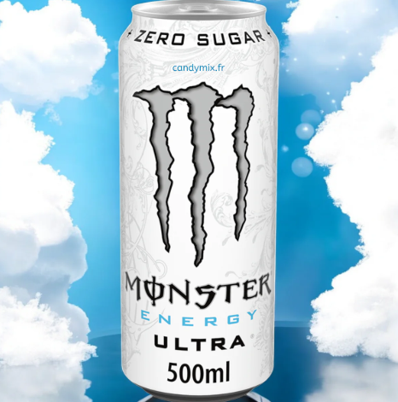
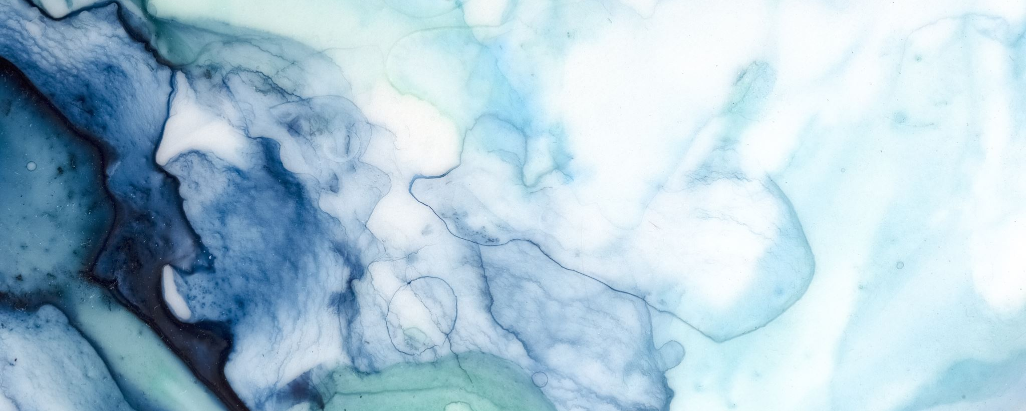
White Monster:
How did I become this strong?

Slide 2
Summary:
My background
Presentation of the product
Scientifically proven benefits
Before/after white monster
Case of Study: Henry Yu
Absolutely objective comparison between me and Trey other athletes

Slide 3
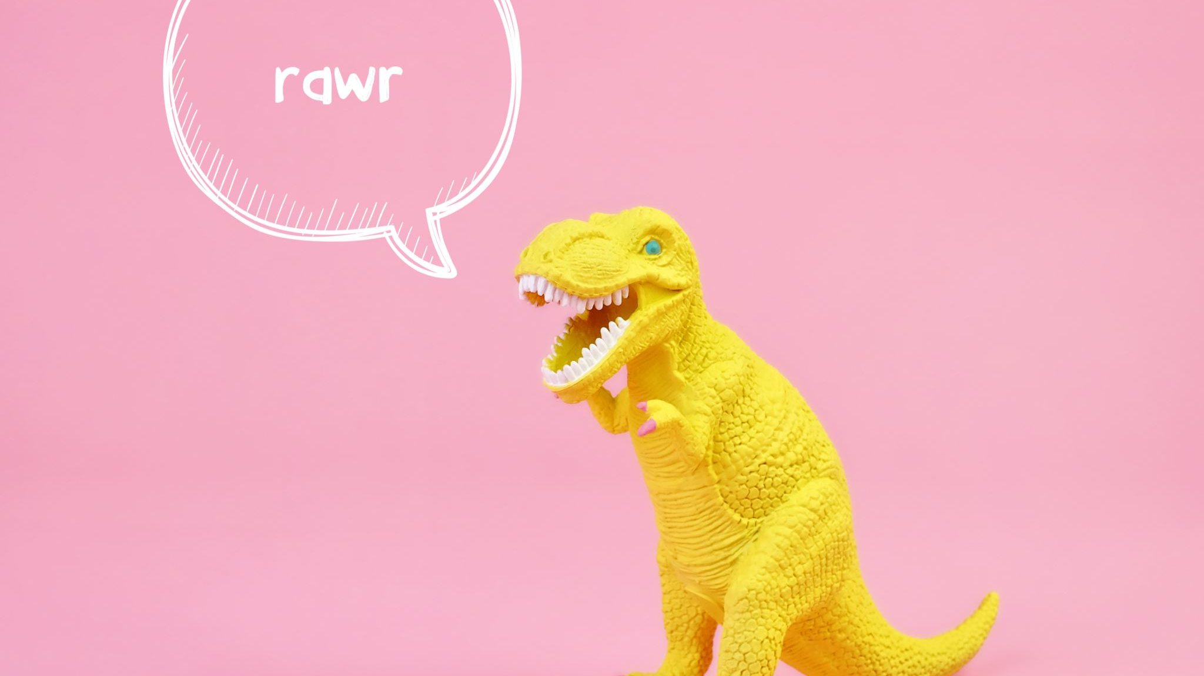
My Background

Slide 4
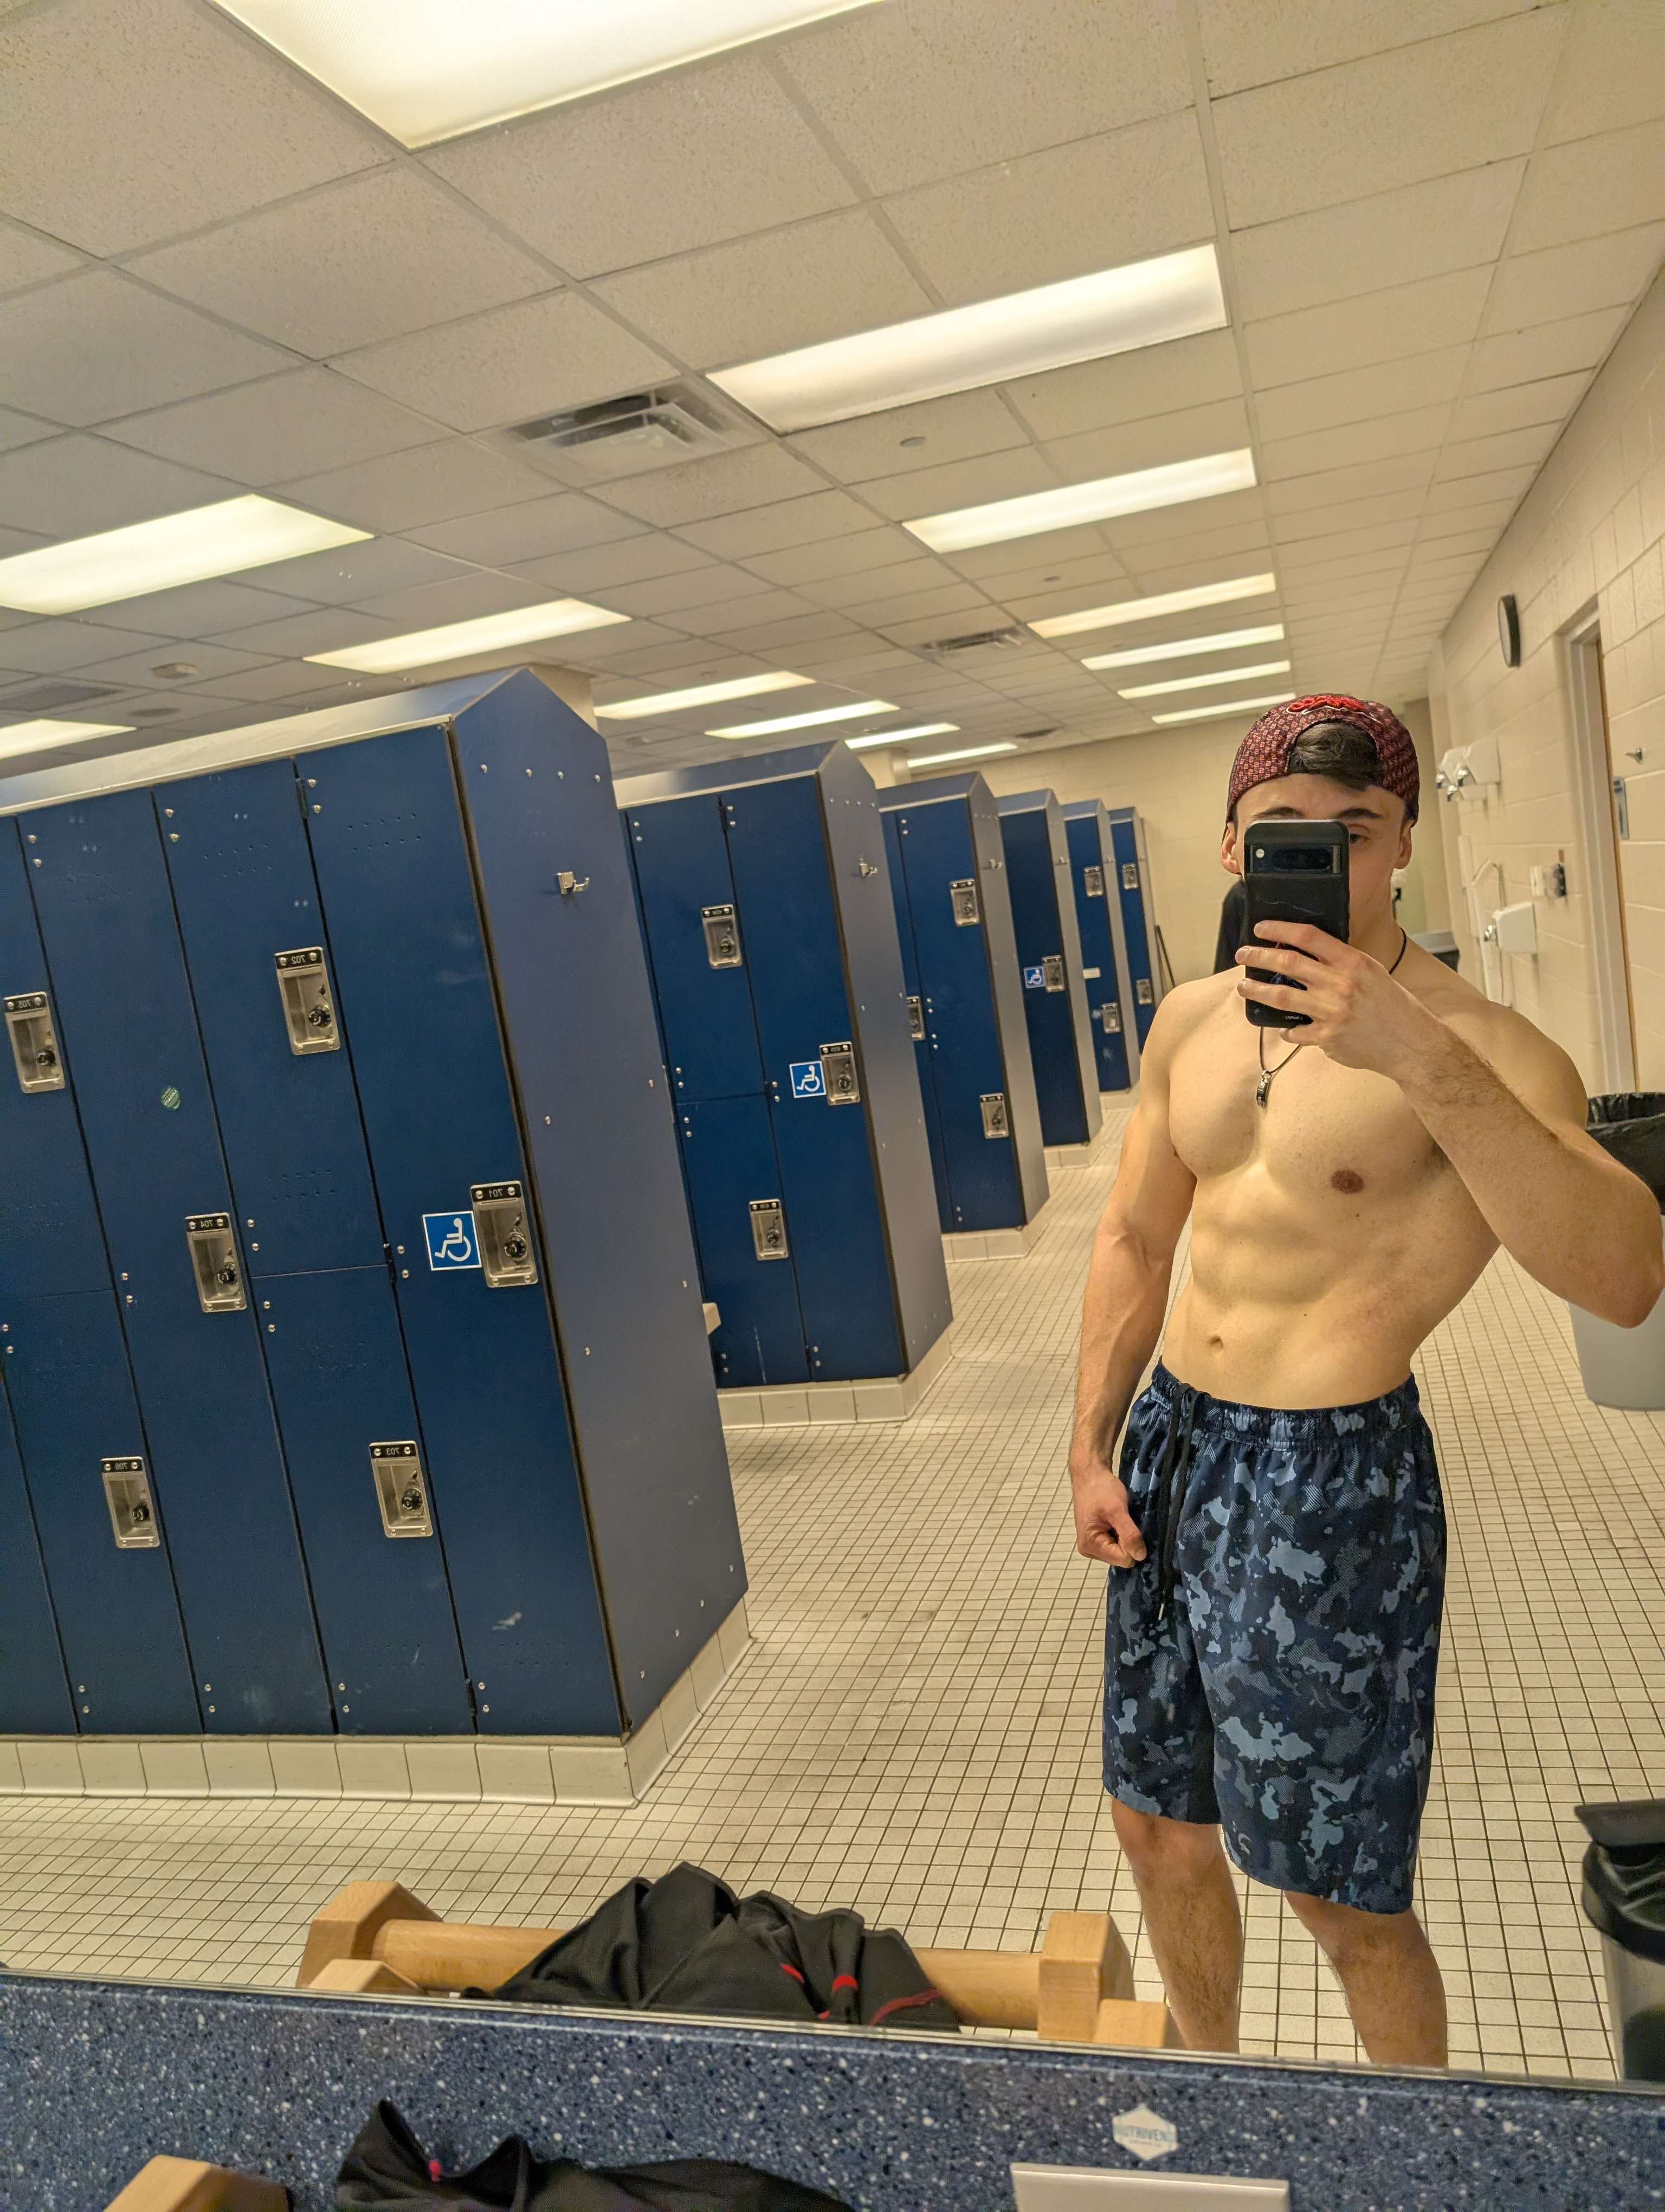
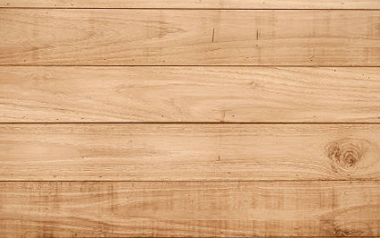
Who am I ?
Calisthenics Athlete for only almost 2years
Portuguese porn actor during my free time (if interested DM me), didn’t see the mustache?
I can planche btw…
Specializing in statics
I can planche
I got no legs
I can planche!!!
NOT ME (JUST A CASE)
ME LOL!!!
My phone with a RHINOSHIELD case (-10% with my code TREYDOYOURFUCKINGPUSHUPS)

Slide 5
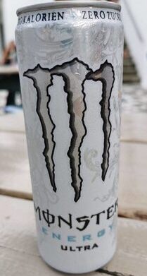
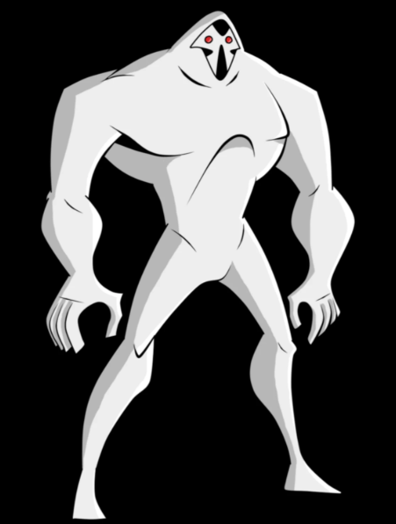
My issues in the sport…
For many years (at least 5): struggle to progress (10 pushups at most, no lying…)
0 pull ups (that is true actually)
But most importantly, joints pain and weak body…
But here my savior appeared!!!
This double dots GOD
Not him

Slide 6
Presentation of the product

Slide 7
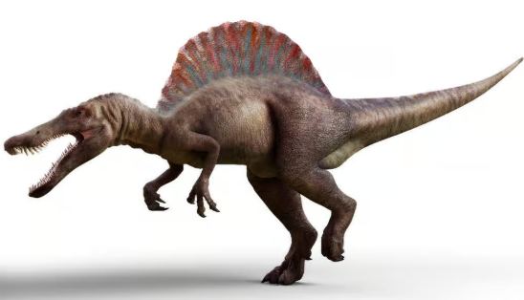
This is a fucking cool spinosaurus
For your insight:

Slide 8
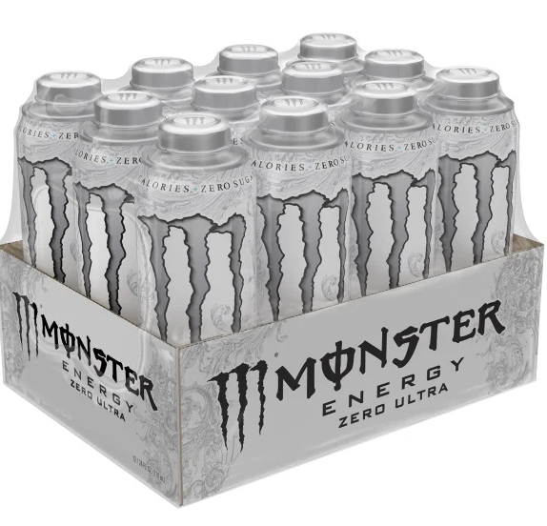
The MIGHTY White Monster
Energy Drink
DIVINE Natural Taste of Lemon and Agrums
10 kcal a can (nothing)
Boosts your performances (look at me)
ORGANIC (yes trust me)
Favorite drink of best athletes (me, me, me, and me…)

Slide 9
Scientifically proven benefits

Slide 10
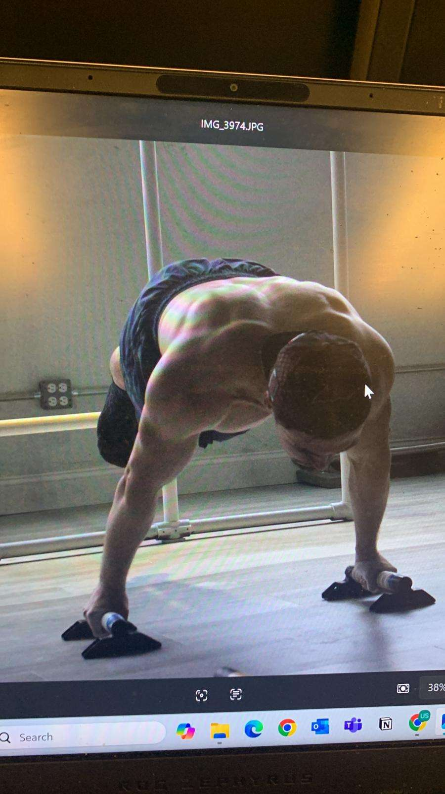
In case I didn’t mention, I can planche
Thanks Trey

Slide 11
Biological proven aspects
https://journals.lww.com/nsca-scj/fulltext/2012/08000/Caffeine,_Energy_Drinks,_and_Strength_Power.3.aspx,%20full-text%20at
Improves strength
Gives planche (full)
Increases your attention and energy (no way)
100% of people consuming white monsters can planche (proof in this room)

Slide 12
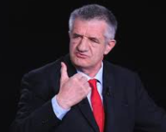
Biological proven aspects
https://pmc.ncbi.nlm.nih.gov/articles/PMC10535526/
Only high doses are dangerous
You would die from over hydration before
I am right

Slide 13
Before vs After White Monster

Slide 14
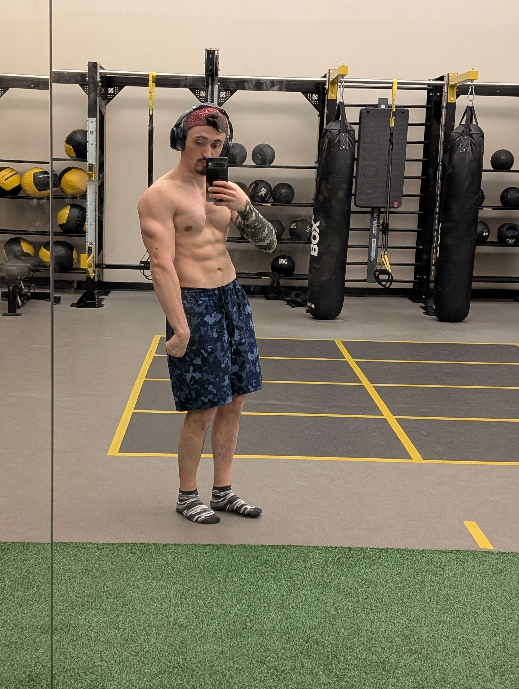
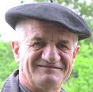
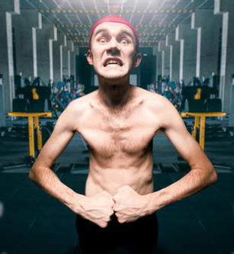
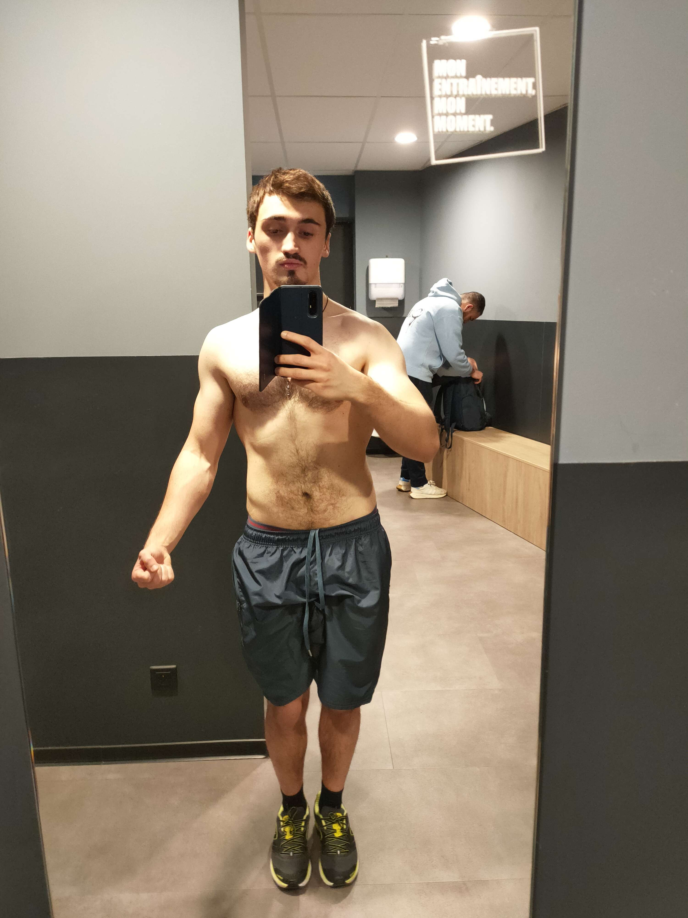
Proof by image
A little bit of Gym and Tren

Slide 15
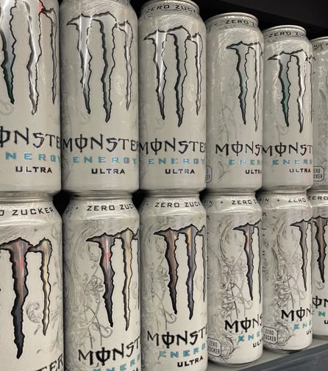
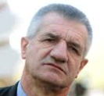
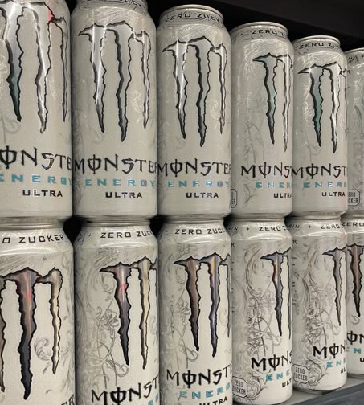
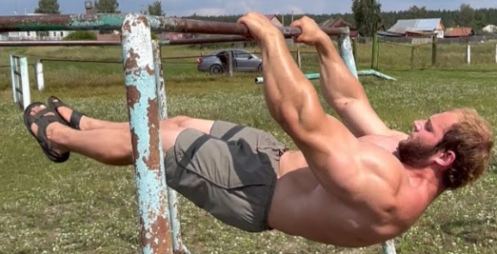
Potential Future (3 days)

Slide 16
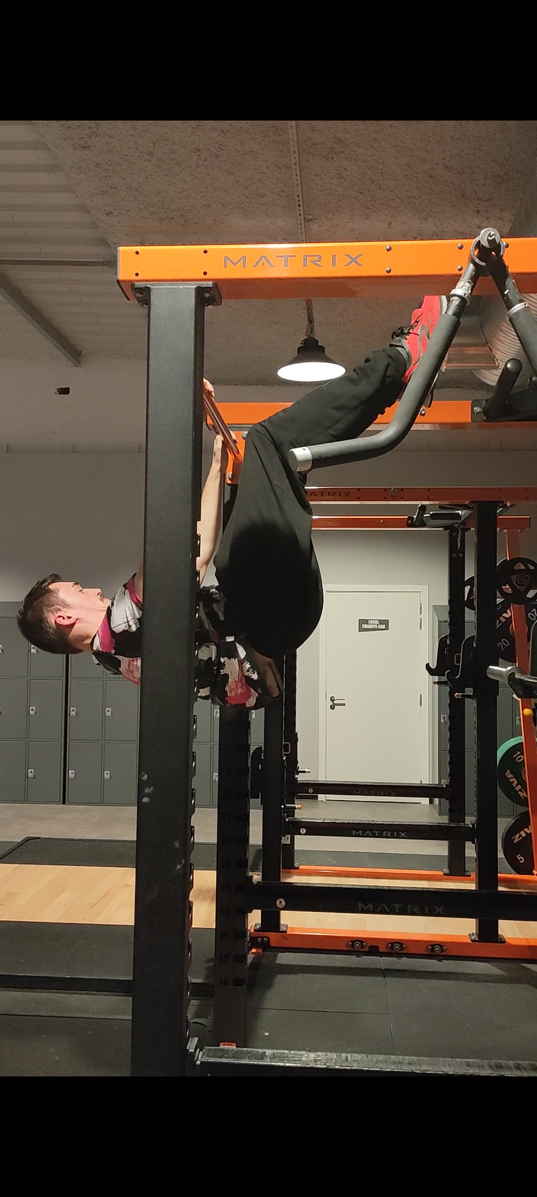
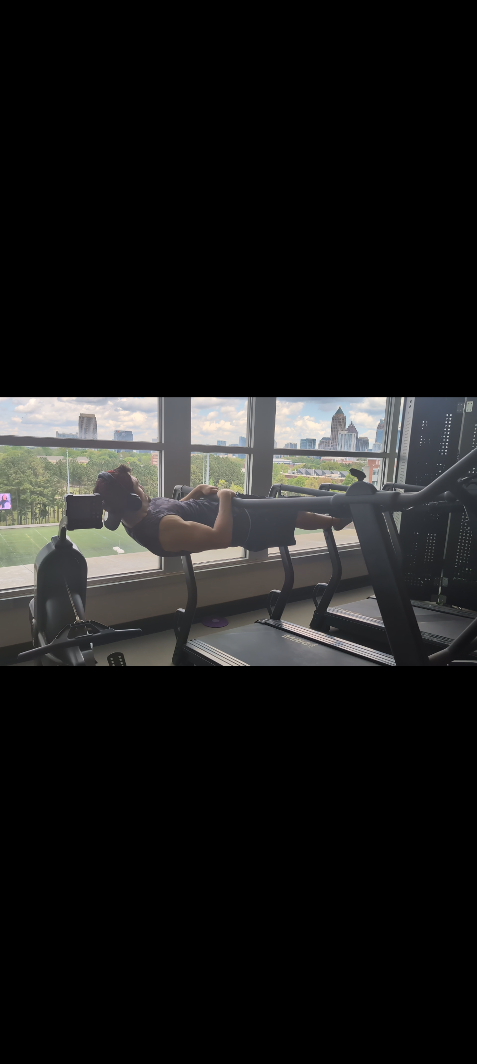
Another proof by image

Slide 17
Case of Study

Slide 18
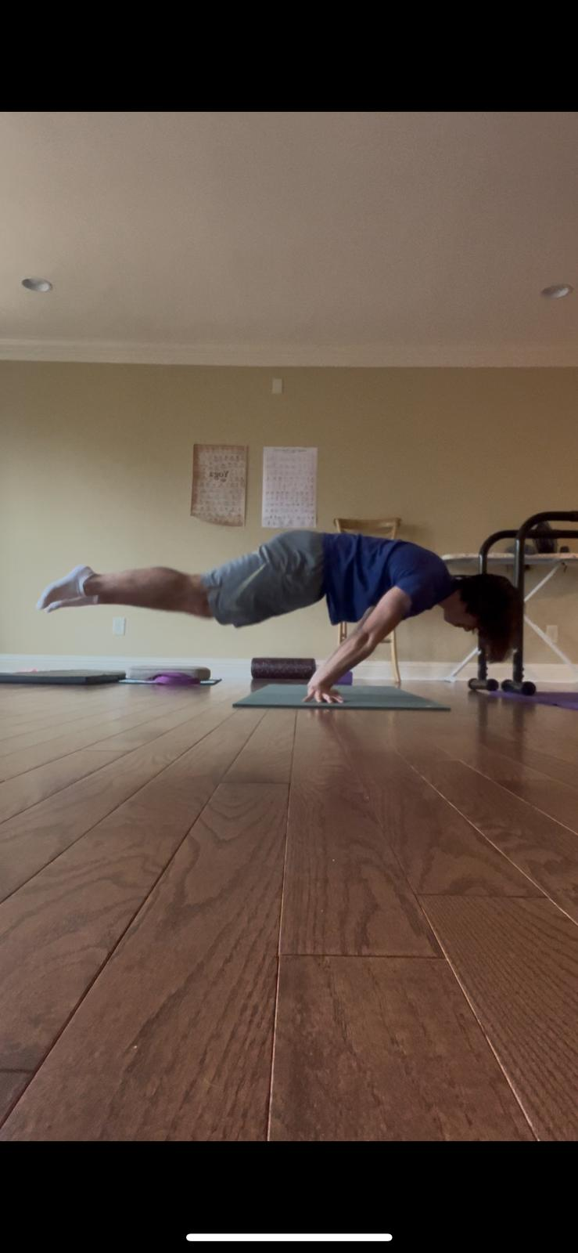
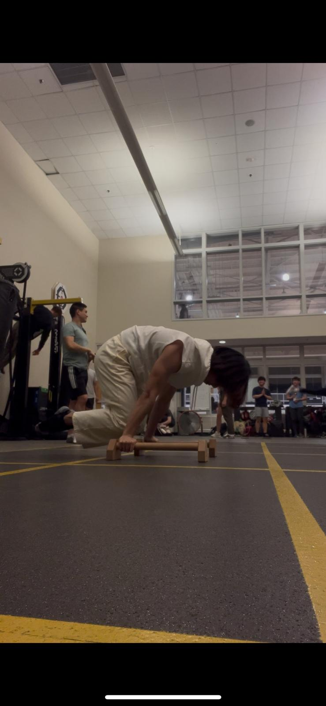
Henry Yu (really good guy, you should meet him)
+ meeting me
Beginning of semester
Now
Well, the presentation may be improved, like his planche…

Slide 19
Absolutely objective comparison with Trey other athletes

Slide 20
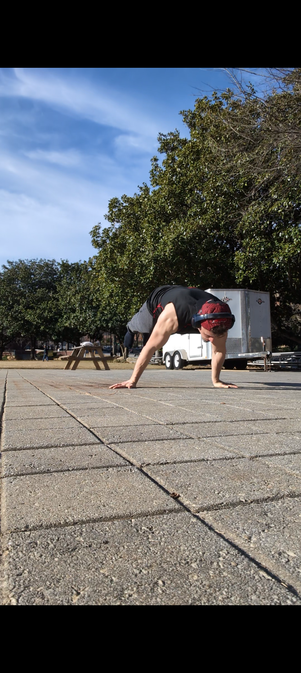
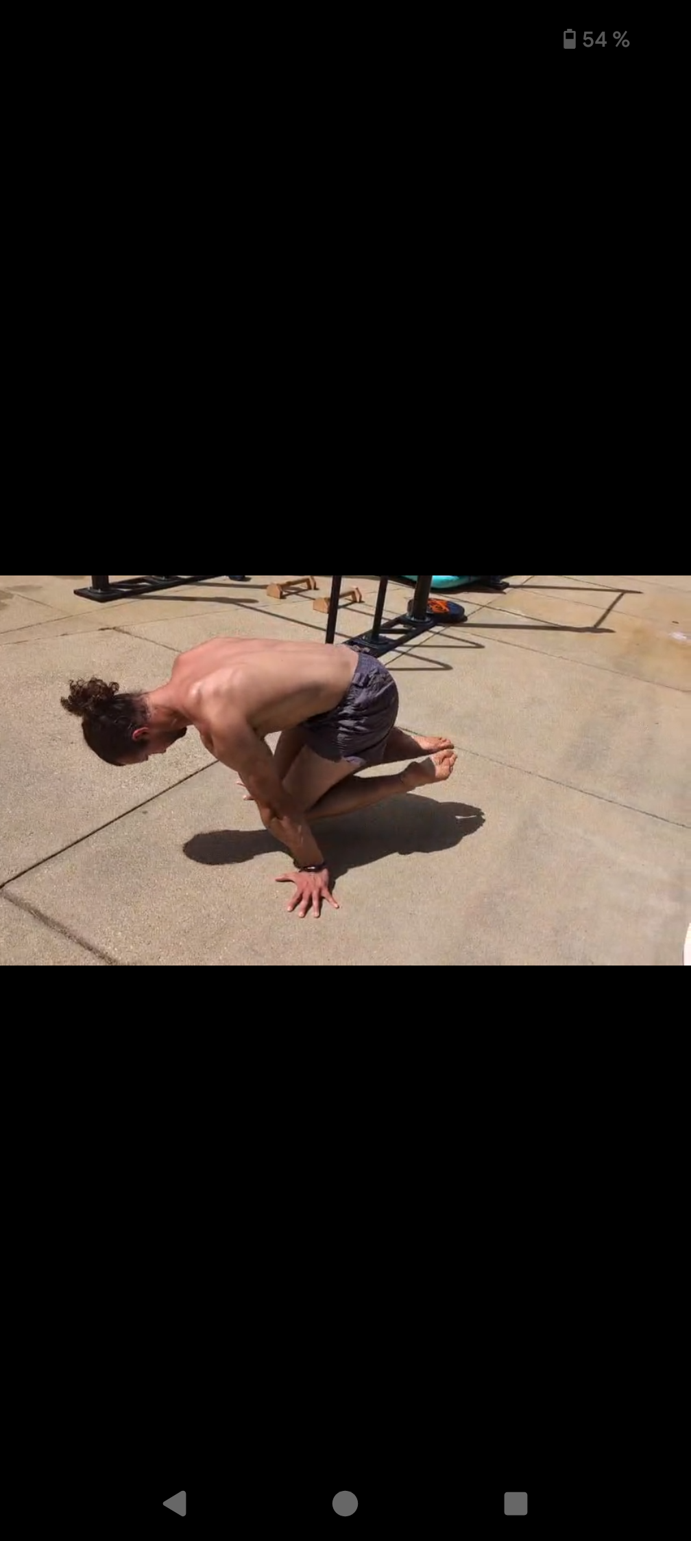
Do I really need to do it? Fine
At least he can Nordic Curl… (who cares?)
Me:
Trey:

Slide 21
Conclusion

Slide 22
Conclusion
White Monster >>> God
White Monster = Life
Red Bull gives you wings, but White Monster gives you planche
Are you a bitch Trey? do your fucking push ups!
Python algorithm showing the truth:
convinced = True
Audience = False
while audience != convinced:
print("read the slides again")
audience = bool(input("are you convinced?“))
print("perfect, white monster always wins!")

